Slide 1
Computer graphics III – Path tracing
Jaroslav Křivánek, MFF UK
Jaroslav.Krivanek@mff.cuni.cz

Slide 2
Tracing paths from the camera
renderImage()
{
for all pixels
{
Color pixelColor = (0,0,0);
for k = 1 to N
{
ω_{k} := random direction through the pixel
pixelColor += getLi(camPos, ω_{k})
}
pixelColor /= N;
writePixel(pixelColor);
}
}

Slide 3
Path tracing, v. zero (recursive form)
getLi (x, ω):
y = traceRay(x, ω)
return
Le(y, –ω) + // emitted radiance
Lr (y, –ω) // reflected radiance
Lr(x, ω):
ω′ = genUniformHemisphereRandomDir( n(x) )
return 2π * brdf(x, ω, ω′) * dot(n(x), ω′) * getLi(x, ω′)

Slide 4
Path Tracing – Loop version
getLi(x, w)
{
Color thrput = (1,1,1)
Color accum = (0,0,0)
while(1)
{
hit = NearestIntersect(x, w)
if no intersection
return accum + thrput * bgRadiance(x, w)
if isOnLightSource(hit)
accum += thrput * Le(hit.pos, -w)
ρ = reflectance(hit.pos, -w)
if rand() < ρ // russian roulette – survive (reflect)
wi := SampleDir(hit)
thrput *= fr(hit.pos, wi, -w) * dot(hit.n, wi) / (ρ * pdf(wi))
x := hit.pos
w := wi
else // absorb
break;
}
return accum;
}

Slide 5
Terminating paths – Russian roulette
getLi(x, w)
{
Color thrput = (1,1,1)
Color accum = (0,0,0)
while(1)
{
hit = NearestIntersect(x, w)
if no intersection
return accum + thrput * bgRadiance(x, w)
if isOnLightSource(hit)
accum += thrput * Le(hit.pos, -w)
ρ = reflectance(hit.pos, -w)
if rand() < ρ // russian roulette – survive (reflect)
wi := SampleDir(hit)
thrput *= fr(hit.pos, wi, -w) * dot(hit.n, wi) / (ρ * pdf(wi))
x := hit.pos
w := wi
else // absorb
break;
}
return accum;
}

Slide 6
Terminating paths – Russian roulette
Continue the path with probability q
Multiply weight (throughput) of surviving paths by 1 / q
RR is unbiased!

Slide 7
Survival probability
It makes sense to use the surface reflectivity ρ as the survival probability
If the surface reflects only 30% of energy, we continue with the probability of 30%. That’s in line with what happens in reality.
What if we cannot calculate ρ? Then there’s a convenient alternative:
First sample a random direction ω_{i} according to p(ω_{i})
Use the sampled ω_{i} it to calculate the survival probability as

Slide 8
Direction sampling
getLi(x, w)
{
Color thrput = (1,1,1)
Color accum = (0,0,0)
while(1)
{
hit = NearestIntersect(x, w)
if no intersection
return accum + thrput * bgRadiance(x, w)
if isOnLightSource(hit)
accum += thrput * Le(hit.pos, -w)
ρ = reflectance(hit.pos, -w)
if rand() < ρ // russian roulette – survive (reflect)
wi := SampleDir(hit)
thrput *= fr(hit.pos, wi, -w) * dot(hit.n, wi) / (ρ * pdf(wi))
x := hit.pos
w := wi
else // absorb
break;
}
return accum;
}

Slide 9
Direction sampling
We usually sample the direction ω_{i} from a pdf similar to
f_{r}(ω_{i}, ω_{o}) cos θ_{i}
Ideally, we would want to sample proportionally to the integrand itself L_{i}(ω_{i}) f_{r}(ω_{i}, ω_{o}) cos θ_{i}, but this is difficult, because we do not know L_{i} upfront. With some precomputation, it is possible to use a rough estimate of L_{i} for sampling [Jensen 95, Vorba et al. 2014], cf. “guiding”.

Slide 10
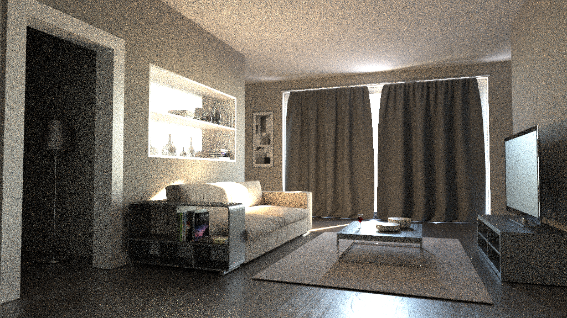
No incoming radiance information [Vorba et al. 2014]
Bidirectional path tracing (1h)
10

Slide 11
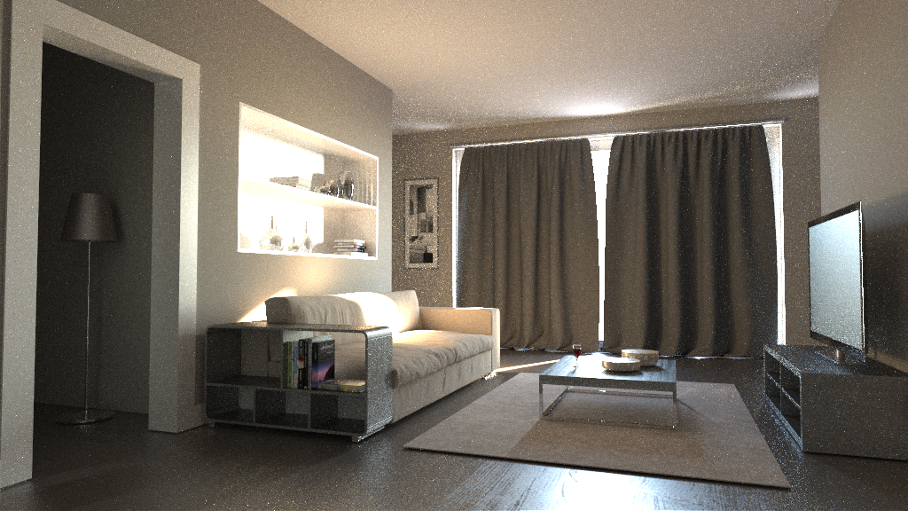
“Guiding” by incoming radiance [Vorba et al. 2014]
Guided bidirectional path tracing (1h)
11

Slide 12
BRDF importance sampling
Let’s see what happens when the pdf is exactly proportional to f_{r}(ω_{i}, ω_{o}) cos θ_{i} ?
Normalization (recall that a pdf must integrate to 1)
The normalization factor is nothing but the reflectance ρ

Slide 13
BRDF IS in a path tracer
Throughput update for a general pdf
...
thrput *= fr(.) * dot(.) / ( ρ * p(wi) )
A pdf that is exactly proportional to BRDF * cos keeps the throughput constant because the different terms cancel out!
...
thrput *= 1
Physicists and nuclear engineers call this the “analog” simulation, because this is how real particles behave.

Slide 14
Direct illumination calculation in a path tracer

Slide 15
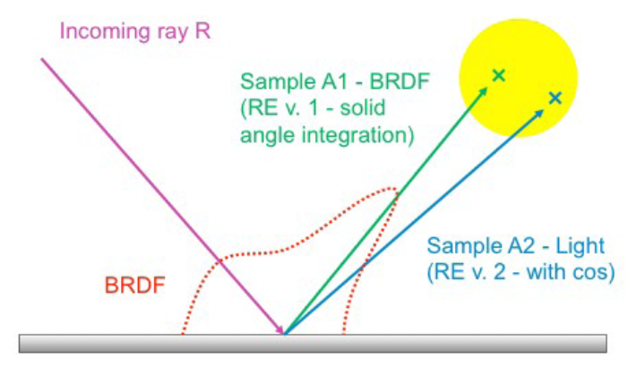
Direct illumination: Two strategies
At each path vertex x, we are calculating direct illumination
i.e. radiance reflected from a point x on a surface exclusively due to the light coming directly from the sources
Two sampling strategies
BRDF-proportional sampling
Light source area sampling
Image: Alexander Wilkie

Slide 16
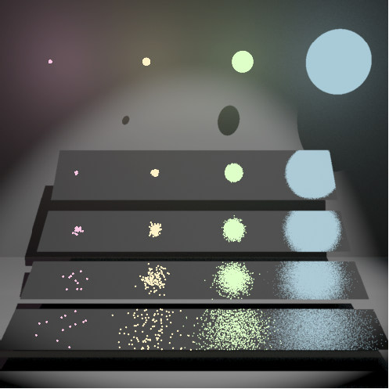
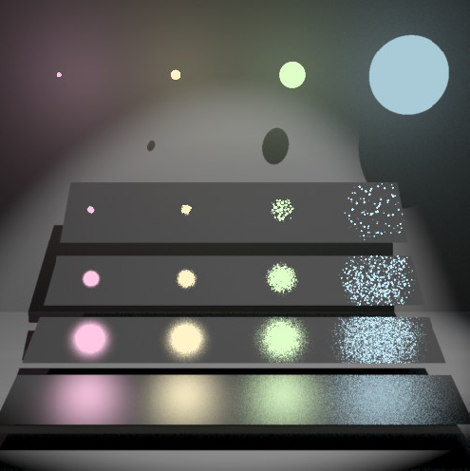
Direct illumination: Two strategies
Images: Eric Veach
BRDF proportional sampling
Light source area sampling

Slide 17
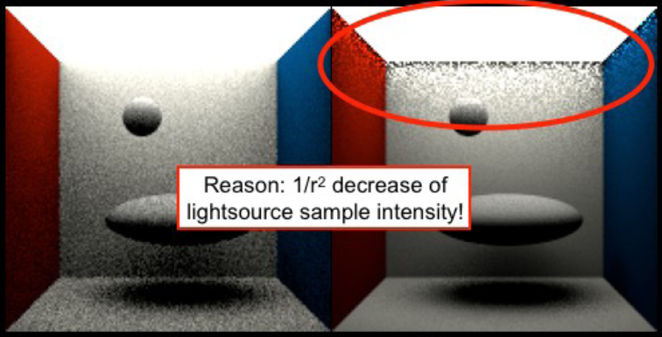
Direct illumination calculation using MIS
Image: Alexander Wilkie
Sampling technique (pdf) p₁: BRDF sampling
Sampling technique (pdf) p₂: Light source area sampling

Slide 18
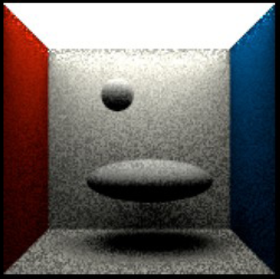
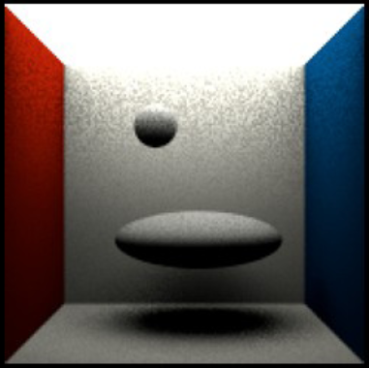
Combination
Image: Alexander Wilkie
Arithmetic average Preserves bad properties of both techniques
Balance heuristic Bingo!!!

Slide 19
MIS weight calculation
Sample weight for BRDF sampling
PDF for BRDF sampling
PDF with which the direction ω_{j} would have been generated, if we used light source area sampling

Slide 20
PDFs
BRDF sampling: p₁(ω)
Depends on the BRDF, e.g. for a Lambertian BRDF:
Light source area sampling: p₂(ω)
Conversion of the uniform pdf 1/|A| from the area measure (dA) to the solid angle measure (dω)

Slide 21
Where is the conversion factor coming from?
Pdfs (unlike ordinary function) change under a change of coordinates. In general, it must always hold:
And so
conversion factor

Slide 22
The use of MIS in a path tracer
For each path vertex:
Generate an explicit shadow ray for the techniques p₂ (light source area sampling)
Secondary ray for technique p₁ (BRDF sampling)
One ray can be shared for the calculation of both direct and indirect illumination
But the MIS weight is – of curse – applied only on the direct term (indirect illumination is added unweighted because there is no second technique to calculate it)

Slide 23
Dealing with multiple light sources
Option 1:
Loop over all sources and send a shadow ray to each one
Option 2:
Choose one source at random (with prob proportional to power)
Sample illumination only on the chosen light, divide the result by the prob of picking that light
(Scales better with many sources but has higher variance per path)
Beware: The probability of choosing a light influences the sampling pds and therefore also the MIS weights.

